Slide 1
Chapter 7: Synchronization Examples

Slide 2
Outline
Explain the bounded-buffer synchronization problem
Explain the readers-writers synchronization problem
Explain and dining-philosophers synchronization problems
Describe the tools used by Linux and Windows to solve synchronization problems.
Illustrate how POSIX and Java can be used to solve process synchronization problems

Slide 3
Classical Problems of Synchronization
Classical problems used to test newly-proposed synchronization schemes
Bounded-Buffer Problem
Readers and Writers Problem
Dining-Philosophers Problem

Slide 4
Bounded-Buffer Problem
n buffers, each can hold one item
Semaphore mutex initialized to the value 1
Semaphore full initialized to the value 0
Semaphore empty initialized to the value n

Slide 5
Bounded Buffer Problem (Cont.)
The structure of the producer process
do {
// produce an item in nextp
wait (empty);
wait (mutex);
// add nextp to the buffer
signal (mutex);
signal (full);
} while (TRUE);
The structure of the consumer process
do {
wait (full);
wait (mutex);
// remove an item from buffer to nextc
signal (mutex);
signal (empty);
// consume the item in nextc
} while (TRUE);
Initially: Empty = N, Full = 0

Slide 6
Readers-Writers Problem
A data set is shared among a number of concurrent processes
Readers – only read the data set; they do not perform any updates
Writers – can both read and write
Problem:
Allow multiple readers to read at the same time
Only one single writer can access the shared data at the same time
Several variations of how readers and writers are considered – all involve some form of priorities

Slide 7
Readers-Writers Problem
First problem -- require no reader will be kept waiting unless a writer has already obtained permission to use the shared object. Thus, no reader should wait for other readers to finish even a writer is waiting.
Second problem -- require once a writer is ready, that writer performs its write as soon as possible, after old readers (or writer) are completed. Thus, if a writer is waiting to access the object, no new readers may start reading.
A solution to either problem may result in starvation
The first problem: Writers
Writers wait, but readers come in one after one
The second problem: Readers
Readers wait, but writers come in one after one

Slide 8
Readers-Writers Problem (Cont.)
Shared data
Data set
Integer read_count initialized to 0
Keeps track of how many processes are currently reading the object
Semaphore mutex initialized to 1
Used to ensure mutual exclusion when the variable read_count is updated
Semaphore wrt_mutex initialized to 1
Functions as a mutual exclusion semaphore for the writers
It also is used by the first or last reader that enters or exits the critical section
It is not used by the readers who enter or exit while other processes are in their critical sections

Slide 9
A Solution for the First Problem
If a writer is in the CS and n readers are waiting, then one reader is queued on wrt_mutex and n-1 readers are queued on mutex.
When a writer executes signal(wrt_mutex), we may assume the execution of either the waiting writers or a single reader. The selection is made by the scheduler.
do {
wait(mutex);
read_count ++;
if (read_count == 1)
wait(wrt_mutex);
signal(mutex);
// reading is performed
wait(mutex);
read_count --;
if (read_count == 0)
signal(wrt_mutex);
signal(mutex);
} while (TRUE);
do {
wait(wrt_mutex);
// writing is performed
signal(wrt_mutex);
} while (TRUE);
First reader
Last reader

Slide 10
A Solution for the First Problem
do {
wait(mutex);
read_count ++;
if (read_count == 1)
wait(wrt_mutex);
signal(mutex);
// reading is performed
wait(mutex);
read_count --;
if (read_count == 0)
signal(wrt_mutex);
signal(mutex);
} while (TRUE);
do {
wait(wrt_mutex);
// writing is performed
signal(wrt_mutex);
} while (TRUE);
First reader
Last reader

Slide 11
Readers-Writers Problem Variations
The solution in previous slide can result in a situation where a writer process never writes. It is referred to as the “First reader-writer” problem.
The “Second reader-writer” problem is a variation the first reader-writer problem that state:
Once a writer is ready to write, no “newly arrived reader” is allowed to read.
Both the first and second may result in starvation, leading to even more variations
Problem is solved on some systems by kernel providing reader-writer locks

Slide 12

Dining-Philosophers Problem
N philosophers sit at a round table with a bowel of rice in the middle.
They spend their lives alternating thinking and eating.
They do not interact with their neighbors.
Occasionally try to pick up 2 chopsticks (one at a time) to eat from bowl
Need both to eat, then release both when done
In the case of 5 philosophers, the shared data
Bowl of rice (data set)
Semaphore chopstick[5] initialized to 1

Slide 13
Dining-Philosophers Problem Algorithm
Semaphore Solution
The structure of Philosopher i:
while (true){
wait (chopstick[i] );
wait (chopstick[ (i + 1) % 5] );
/* eat for a while */
signal (chopstick[i] );
signal (chopstick[ (i + 1) % 5] );
/* think for a while */
}
What is the problem with this algorithm?
Deadlock !!

Slide 14
Monitor Solution to Dining Philosophers
monitor DiningPhilosophers
{
enum {THINKING, HUNGRY, EATING} state [5];
condition self [5];
void pickup (int i) {
state[i] = HUNGRY;
test(i);
if (state[i] != EATING) self[i].wait();
}
void putdown (int i) {
state[i] = THINKING;
// test left and right neighbors
test((i + 4) % 5);
test((i + 1) % 5);
}

Slide 15
Monitor Solution to Dining Philosophers (Cont.)
void test (int i) {
if ((state[(i + 4) % 5] != EATING) &&
(state[i] == HUNGRY) &&
(state[(i + 1) % 5] != EATING) )
{
state[i] = EATING;
self[i].signal();
}
}
initialization_code() {
for (int i = 0; i < 5; i++)
state[i] = THINKING;
}
}

Slide 16
Monitor Solution to Dining Philosophers (Cont.)
Each philosopher “i” invokes the operations pickup() and putdown() in the following sequence:
DiningPhilosophers.pickup(i);
/** EAT **/
DiningPhilosophers.putdown(i);
No deadlock, but starvation is possible

Slide 17
Possible Solutions to the Deadlock Problem
Allow at most four philosophers to be sitting simultaneously at the table (while still maintaining five chopsticks).
Allow a philosopher to pick up her chopsticks only if both chopsticks are available (note that she must pick them up in a critical section).
Use an asymmetric solution. Thus,
an odd philosopher picks up first her left chopstick and then her right chopstick, whereas
an even philosopher picks up her right chopstick and then her left chopstick.

Slide 18
Kernel Synchronization - Windows
Uses interrupt masks to protect access to global resources on uniprocessor systems
Uses spinlocks on multiprocessor systems
Spinlocking-thread will never be preempted
Also provides dispatcher objects user-land which may act mutexes, semaphores, events, and timers
Events
An event acts much like a condition variable
Timers notify one or more thread when time expired
Dispatcher objects either signaled-state (object available) or non-signaled state (thread will block)

Slide 19
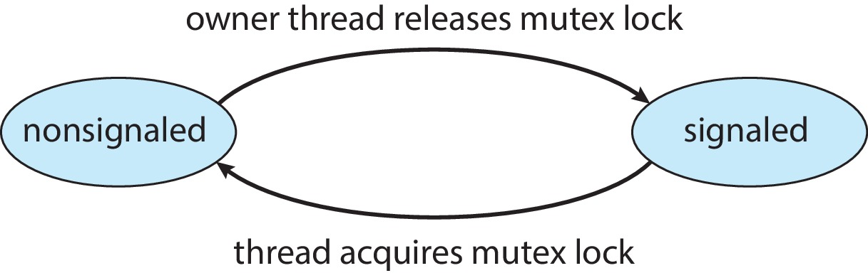
Kernel Synchronization - Windows
Mutex dispatcher object

Slide 20
Linux Synchronization
Linux:
Prior to kernel Version 2.6, disables interrupts to implement short critical sections
Version 2.6 and later, fully preemptive
Linux provides:
Semaphores
Atomic integers
Spinlocks
Reader-writer versions of both
On single-CPU system, spinlocks replaced by enabling and disabling kernel preemption

Slide 21
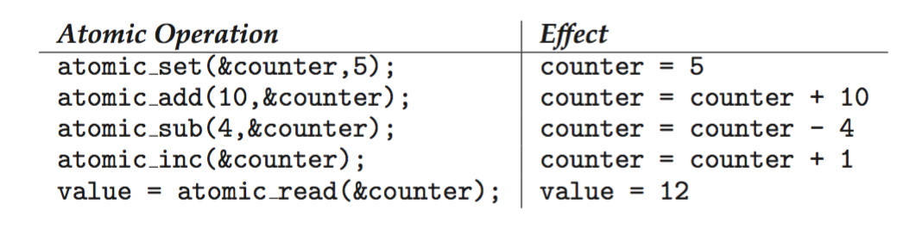
Linux Synchronization
Atomic variables atomic_t is the type for atomic integer
Consider the variables atomic_t counter; int value;

Slide 22
POSIX Synchronization
POSIX API provides
mutex locks
semaphores
condition variable
Widely used on UNIX, Linux, and macOS

Slide 23
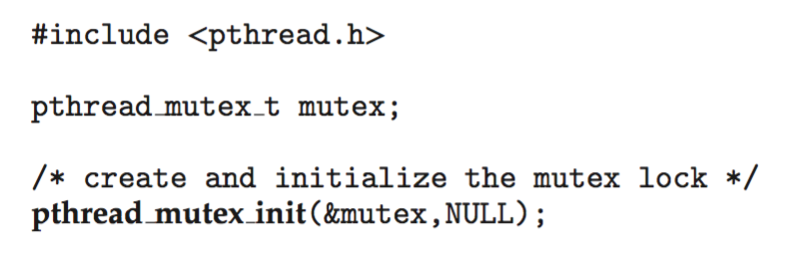
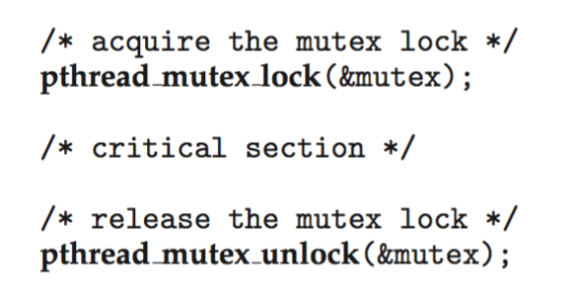
POSIX Mutex Locks
Creating and initializing the lock
Acquiring and releasing the lock

Slide 24
POSIX Semaphores
POSIX provides two versions – named and unnamed.
Named semaphores can be used by unrelated processes, unnamed cannot.

Slide 25
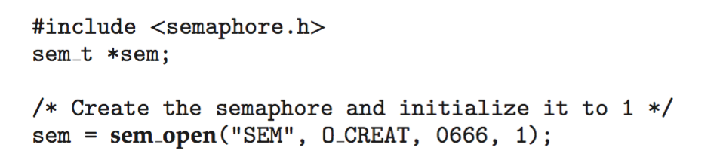
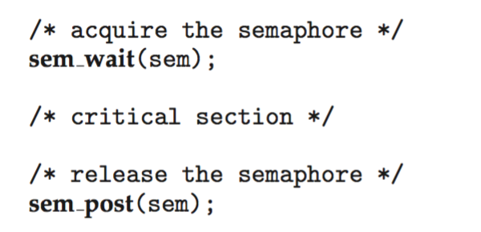
POSIX Named Semaphores
Creating and initializing the semaphore:
Another process can access the semaphore by referring to its name SEM.
Acquiring and releasing the semaphore:

Slide 26
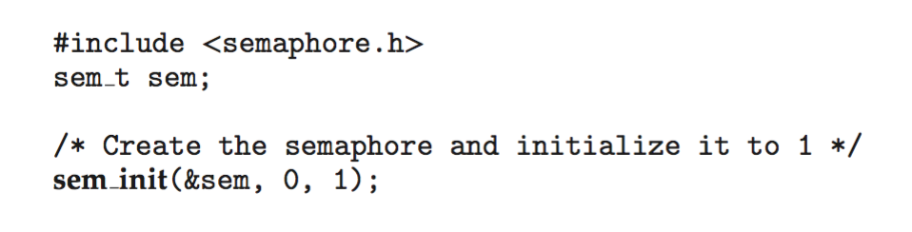
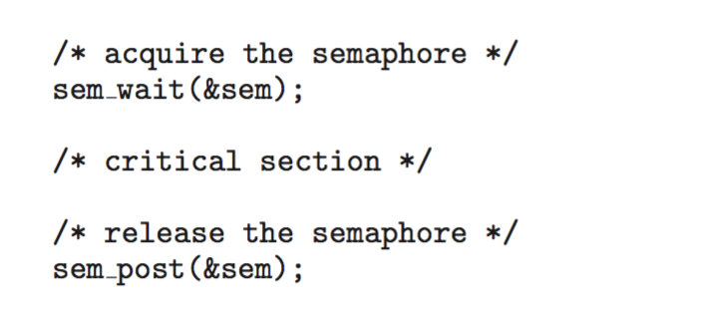
POSIX Unnamed Semaphores
Creating and initializing the semaphore:
Acquiring and releasing the semaphore:

Slide 27
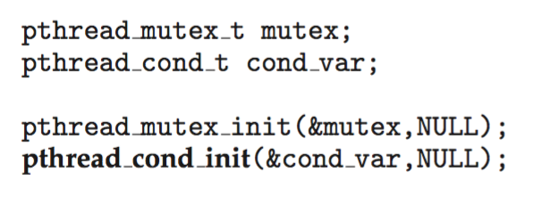
POSIX Condition Variables
Since POSIX is typically used in C/C++ and these languages do not provide a monitor (prior to C++11), POSIX condition variables are associated with a POSIX mutex lock to provide mutual exclusion: Creating and initializing the condition variable:

Slide 28
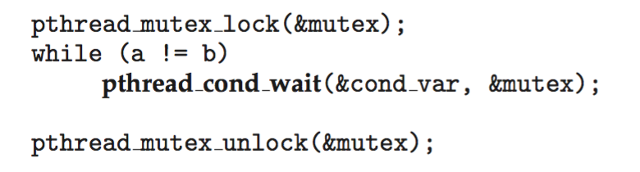
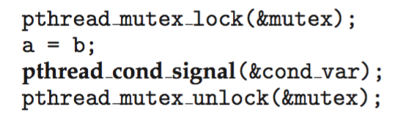
POSIX Condition Variables
Thread waiting for the condition a == b to become true:
Thread signaling another thread waiting on the condition variable:

Slide 29
Java Synchronization
Java provides rich set of synchronization features:
Java monitors
Reentrant locks
Semaphores
Condition variables

Slide 30
Java Monitors
Every Java object has associated with it a single lock.
If a method is declared as synchronized, a calling thread must own the lock for the object.
If the lock is owned by another thread, the calling thread must wait for the lock until it is released.
Locks are released when the owning thread exits the synchronized method.

Slide 31
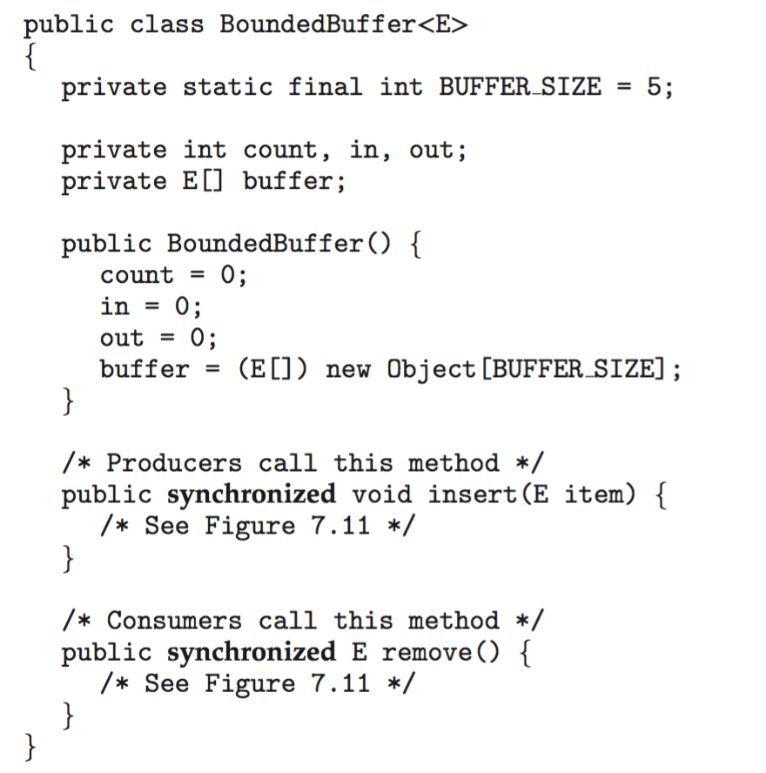
Bounded Buffer – Java Synchronization

Slide 32
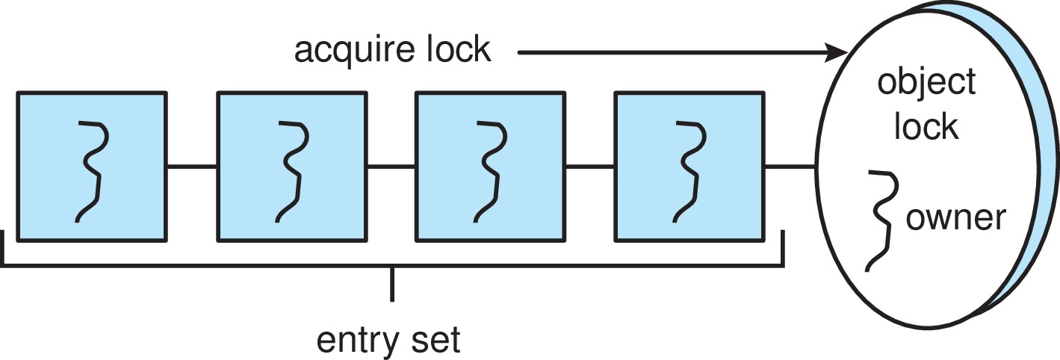
Java Synchronization
A thread that tries to acquire an unavailable lock is placed in the object’s entry set:

Slide 33
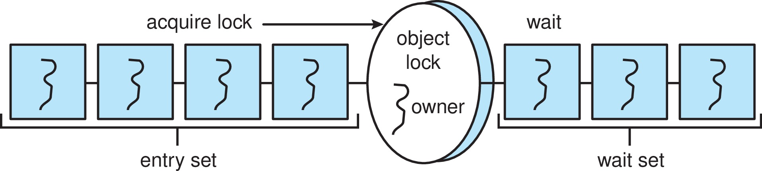
Java Synchronization
Similarly, each object also has a wait set.
When a thread calls wait():
It releases the lock for the object
The state of the thread is set to blocked
The thread is placed in the wait set for the object

Slide 34
Java Synchronization
A thread typically calls wait() when it is waiting for a condition to become true.
How does a thread get notified?
When a thread calls notify():
An arbitrary thread T is selected from the wait set
T is moved from the wait set to the entry set
Set the state of T from blocked to runnable.
T can now compete for the lock to check if the condition it was waiting for is now true.

Slide 35
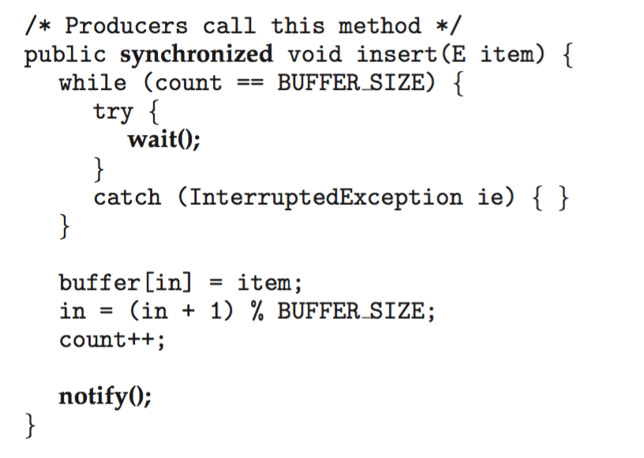
Bounded Buffer – Java Synchronization

Slide 36
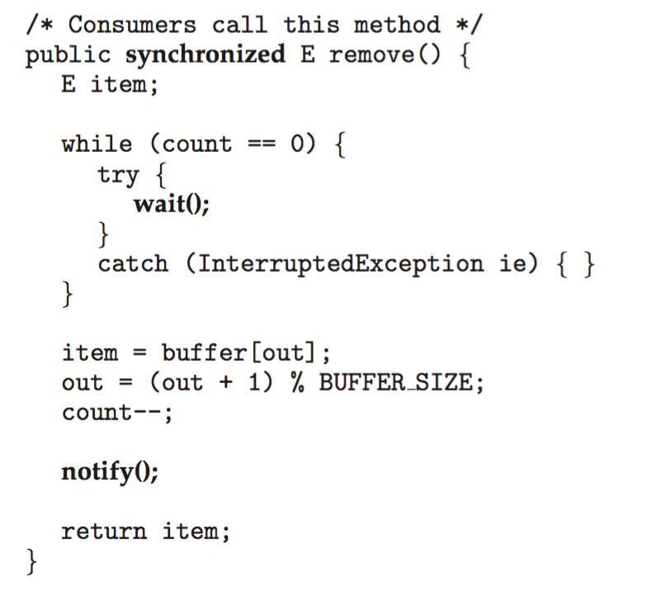
Bounded Buffer – Java Synchronization

Slide 37
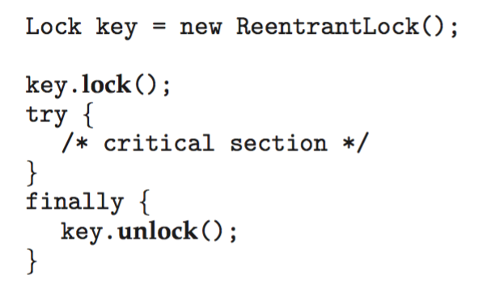
Java Reentrant Locks
Similar to mutex locks
The finally clause ensures the lock will be released in case an exception occurs in the try block.

Slide 38

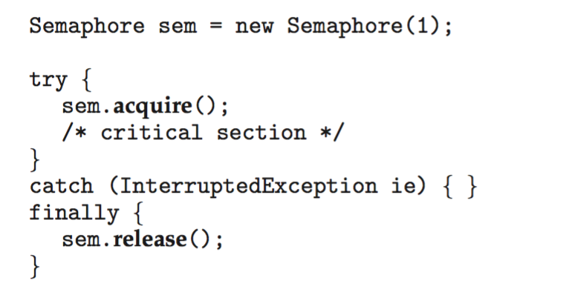
Java Semaphores
Constructor:
Usage:

Slide 39

Java Condition Variables
Condition variables are associated with an ReentrantLock.
Creating a condition variable using newCondition() method of ReentrantLock:
A thread waits by calling the await() method, and signals by calling the signal() method.

Slide 40
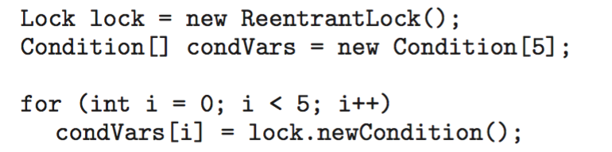
Example
Five threads numbered 0 .. 4
Shared variable turn indicating which thread’s turn it is.
Thread calls doWork() when it wishes to do some work. (But it may only do work if it is their turn.
If not their turn, wait
If their turn, do some work for awhile …...
When completed, notify the thread whose turn is next.
Necessary data structures:

Slide 41
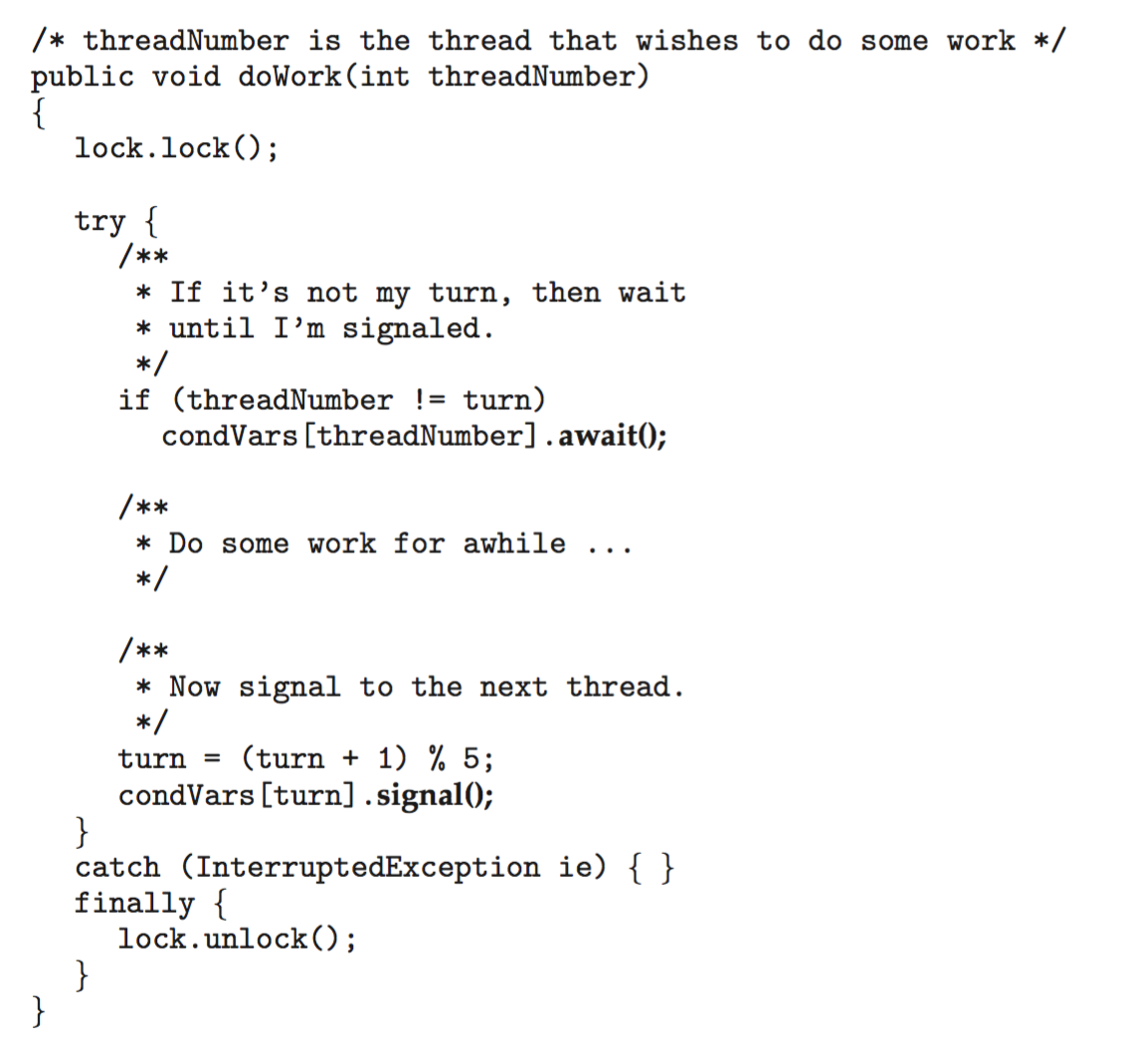
Example

Slide 42
Alternative Approaches
Transactional Memory
OpenMP
Functional Programming Languages

Slide 43
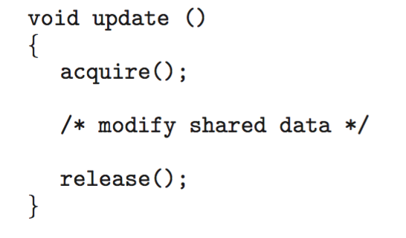
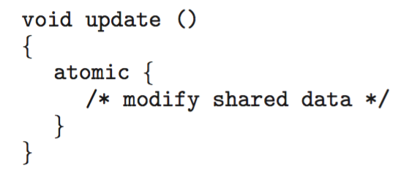
Transactional Memory
Consider a function update() that must be called atomically. One option is to use mutex locks:
A memory transaction is a sequence of read-write operations to memory that are performed atomically. A transaction can be completed by adding atomic{S} which ensure statements in S are executed atomically:

Slide 44
OpenMP
OpenMP is a set of compiler directives and API that support parallel programming.
void update(int value)
{
#pragma omp critical
{
count += value;
}
}
The code contained within the #pragma omp critical directive is treated as a critical section and performed atomically.

Slide 45
Functional Programming Languages
Functional programming languages offer a different paradigm than procedural languages in that they do not maintain state.
Variables are treated as immutable and cannot change state once they have been assigned a value.
There is increasing interest in functional languages such as Erlang and Scala for their approach in handling data races.

Slide 46
End of Chapter 7

